Slide 1


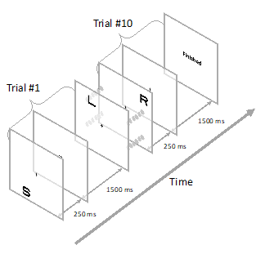
Acuity perimetry with speech input for mapping macular visual field in glaucoma
5494
Hatem Barhoom^{1, 2}; Paul H. Artes¹; Mahesh R. Joshi¹; Gunnar Schmidtmann¹
1. Eye & Vision Research Group, School of Health Professions, University of Plymouth, Plymouth, United Kingdom.
2. Islamic University of Gaza, Gaza, State of Palestine.
Email: hatem.barhoom@Plymouth.ac.uk
PURPOSE
RESULTS
Healthy eyes
Glaucomatous eyes
Acuity perimetry may be more efficient compared to contrast detection in assessing macular visual field defects¹⁻³
We explored the use of letters as stimuli and speech as a response method to measure macular visual sensitivity in healthy observers and those with glaucoma
The letter acuity showed the expected gradient as a function of eccentricity
A Resolution thresholds showed a good topographical correspondence with the contrast
threshold
B Resolution thresholds correlated closely with conventional perimetry at each quadrant
A
METHODS
B
11 healthy eyes
10 glaucomatous eyes
Single interval 10 AFC paradigm
Stimuli: A, T, O, L, N, S, U, Y, Z Sloan letters
Letter acuity was estimated at 13 test locations within central 8˚
For glaucomatous eyes , conventional macular VF performed for comparison
A speech recognition algorithm⁴ was used as response method
The perceived difficulty of the task was assessed via questionnaire : 11 items were used
Questionnaire
The novel aspects of the test did not affect the observers’ performance negatively
CONCLUSIONS
REFERENCES
Results show that letter acuity perimetry with speech input is a feasible method to capture macular damage in glaucoma
All observers found the task intuitive and easy to perform independently
These approaches may lead to more intuitive and patient-friendly tests for macular visual field assessments
Anderson, R. S. (2006). The psychophysics of glaucoma: improving the structure/function relationship. Progress in retinal and eye research, 25(1), 79-97.
Phelps, C. D. (1984). Acuity perimetry and glaucoma. Transactions of the American Ophthalmological Society, 82, 753
Rankin, S. J. (1999). Tumbling E resolution perimetry in glaucoma. In Perimetry Update 1998/1999: Proceedings of the XIIIth International Perimetric Society Meeting, Gardone Riviera (BS), Italy, September 6-9, 1998 (Vol. 1999, pp. 179-186). Kugler Publications.
Selvaraaju Murugesan (2022). Speech Recognition (https://www.mathworks.com/matlabcentral/ fileexchange/47220-speech-recognition), MATLAB Central File Exchange. Retrieved November 9, 2022.

